Slide 1
Allegheny county - Neighborhoods
Kelly Rhoton
4/17/19

Slide 2
Profile of Pittsburgh
Background
Pittsburgh remains one of the most affordable cities in the United States. When families are looking for an area to purchase a home, they use many factors such as school district rating, affordability, walkability, and the proximity to venues like restaurants, parks or libraries. I will use various datasets to segment Pittsburgh. I will first segment Pittsburgh by North Hills, South Hills, East, West Hills and the City of Pittsburgh. Are there areas in each group that are comparable? (Similar school district ranking, average lot/home size, average home price per sq. foot, average age of homes, types of homes (single family, apartments, etc.), etc.)

Slide 3
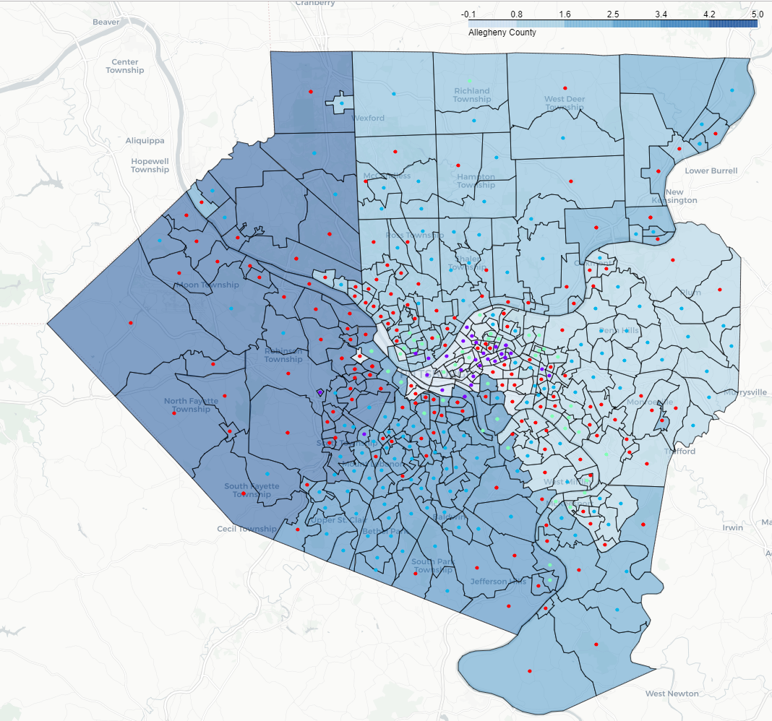
Areas of Pittsburgh
The City of Pittsburgh
West Hills Suburbs
North Hills Suburbs
East Suburbs
South Hills Suburbs

Slide 4
Data acquisition and cleaning
Allegheny County parcel data - https://catalog.data.gov/dataset/allegheny-county-property-sale-transactions
Census Data – Census.gov
Demographics - Census.gov
SchoolDigger.com – for school district ranking

Slide 5
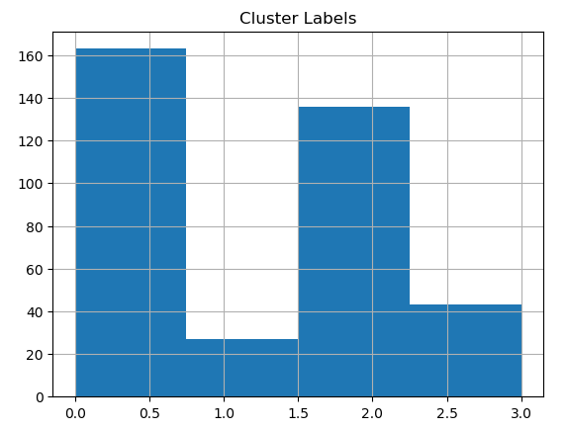
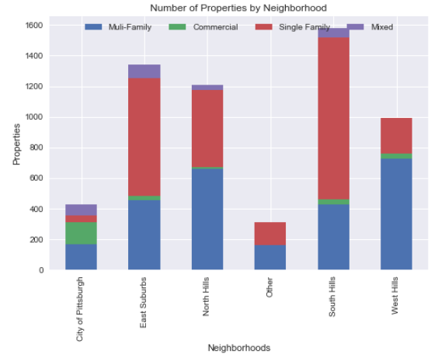
Methodology
Property Clustering with K-Means
Cluster Distribution
Cluster | Description
0 - Multi-Family | Row houses, condominiums, and some single family homes
1 - Commercial | Office buildings, government building and some homes
2 – Single Family | Mostly single family homes
3 – Mixed | A mix between multi-family, single family

Slide 6
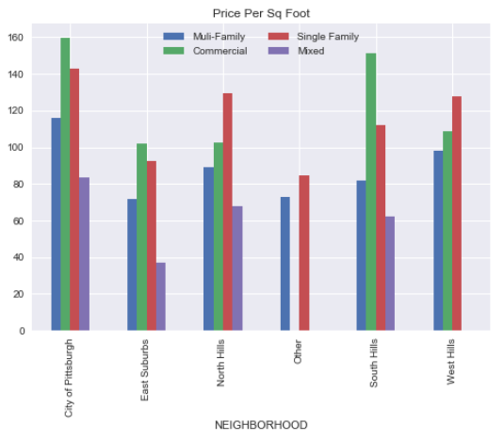
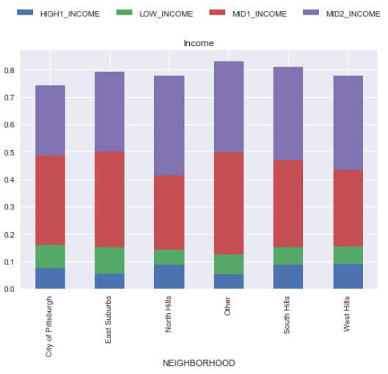
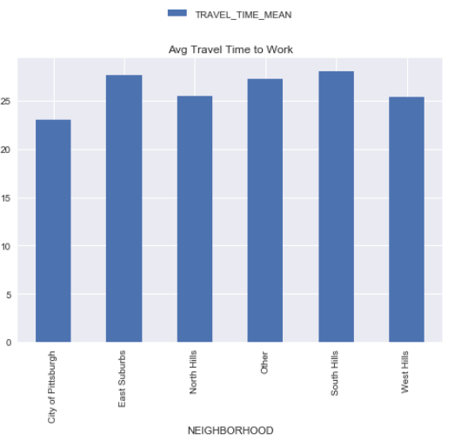
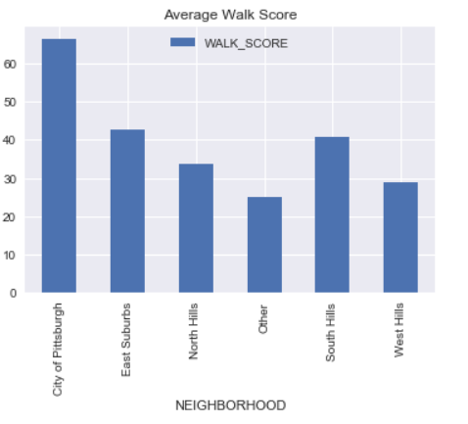
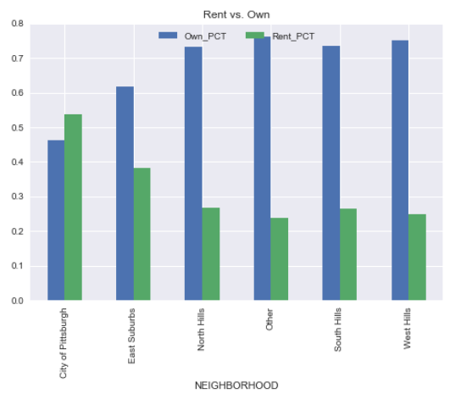
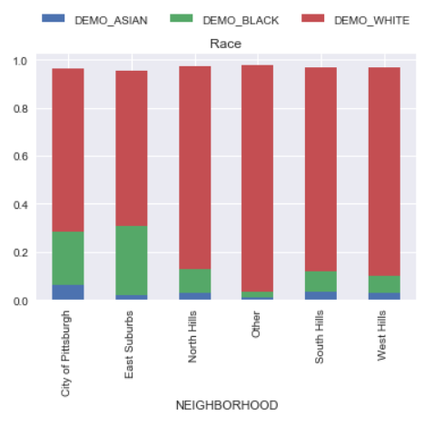
RESULTS

Slide 7
conclusion
Pittsburgh is an affordable city with many neighborhoods to choose from. Even though there is diversity in the type of home, neighborhood and distance from the city, there is not very much racial diversity in any part of town.
The City of Pittsburgh – The city has some of the highest price per square foot which might explain why it also has the highest number of renters. I was surprised to see that the average commute time to work was the same as other neighborhoods. Obviously, the city has the highest racial diversity, walk score and the most commercial clusters. There are neighborhoods within Pittsburgh with really high price per square foot and some with low prices.
West Hills – The west hills’ price per square foot is slightly higher than other areas (for single family homes). The school districts are mostly average with the exception of Quaker Valley in Sewickley.
The East Suburbs – Single family home prices are the lowest in the east and is slightly more diverse (racially and income) than the other suburbs. The schools, however, are not ranked the highest.
South Hills – The south hills have the second highest walk score. It has a low percentage of renters and schools that are ranked high (Upper St. Clair & Mt. Lebanon)
North Hills – The north hills has options for highly ranked schools. (Fox Chapel, North Allegheny, etc) It also has a slightly lower commute time.

